Slide 1
Selecting an Oscillator to Solve 5G Synchronization Challenges
ITSF 2018
Nazariy Tshchynskyy

Slide 2
What is driving oscillator requirements?
System architecture
  SyncE (MTIE, TDEV G.8262)
  PTP (Time Error)
  PTP + SyncE Hybrid Mode (G.8262, Time Error G.8273.2)
  Holdover requirements
Environment conditions
  Magnitude of Temperature variations
  Speed of Temperature variations
  Breezy air

Slide 3
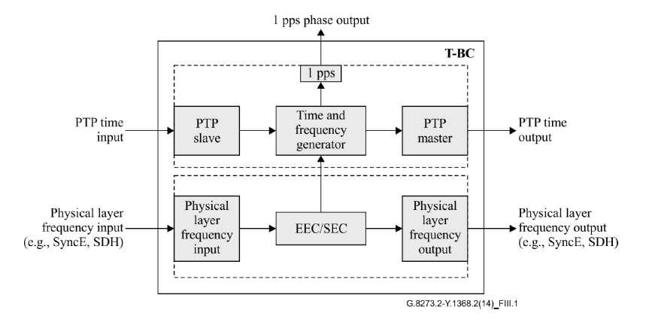
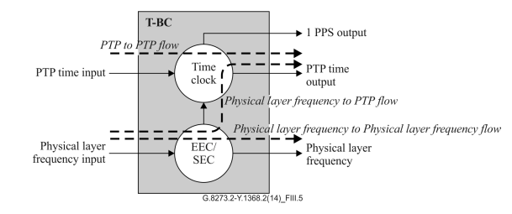
PTP + SyncE (Hybrid Mode) is most commonly used
Hybrid mode uses SyncE physical layer frequency to assist PTP
Helps to achieve Time Error performance
Hybrid mode means stable reference clock traceable to PRC as reference to PTP
Boundary Clock model according to ITU-T G8273.2
Simplified Boundary Clock model according to ITU-T G8273.2

Slide 4
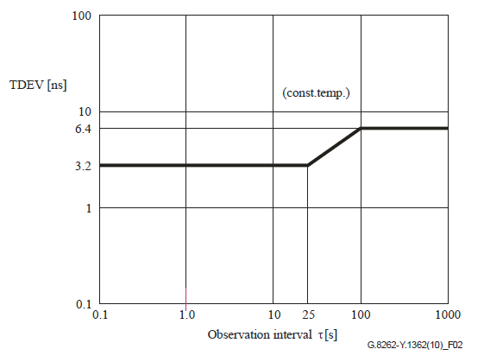
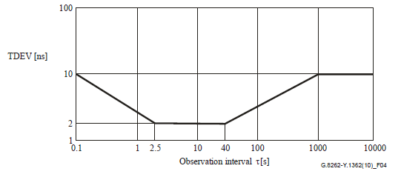
SyncE Requirements
Stability of Local Oscillator has direct impact on Wander Generation performance defined in ITU-T G.8262
Wander generation (TDEV) for EEC-Option 1
Wander generation (TDEV) for EEC-Option 2

Slide 5
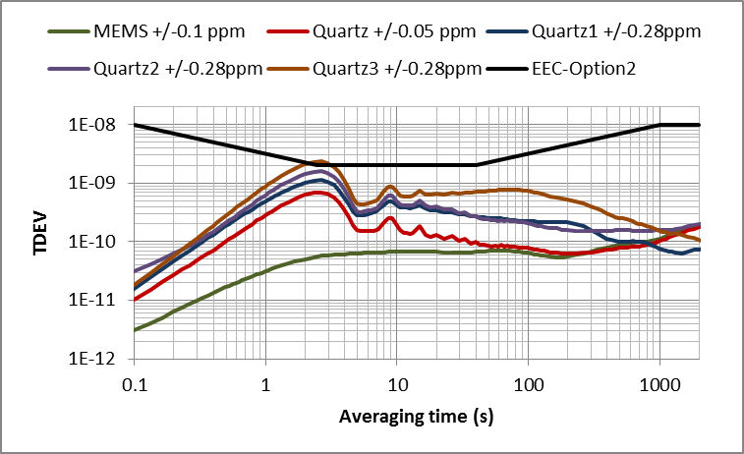
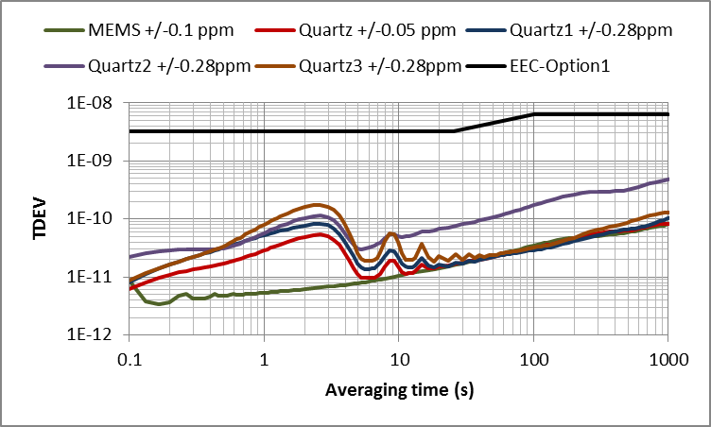
SyncE Performance in Breezy Air
Airflow fluctuations are modulating frequency of the local oscillator
MEMS TCXO’s can track fast airflow changes (Breezy Air)
0.1 Hz PLL BW
3 Hz PLL BW

Slide 6
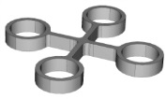
DualMEMSTM with TurboCompensationTM Enables Highest Dynamic Performance
MEMS
Thermally Coupled
Mixed-Signal CMOS IC
On-Chip Regulators
TempFlat™
Resonator
Frac-N PLL
Frequency Synthesis
OSC-Timing
Dividers
& Driver
CLK
Temp
Sense
(TDC)
Temp
Comp
OSC-Temp
VCXO ADC
I/O
Temp
Sensor
I2C
Vctrl
OE
TempFlat™ MEMS Resonator
No aging
No activity dips
30x better vibration immunity
DualMEMS™ Temp Sensing 100% Thermal Coupling
30 µK, 10x more accurate
350 Hz tracking, 40x faster
Airflow, temp ramp resistant

Slide 7

MEMS Temperature Sensor Advantages
Elite DualMEMS™ Temperature Sensor
Quartz TCXO
DualMEMS™ Resonator Die
Quartz temperature
matters
TempFlat™
Resonator
Metal Lid
Quartz
CMOS
Temp Sensing
Resonator
Temperature sensor
measures IC temperature
Best thermal coupling between two MEMS resonators in same die
Digital low noise high bandwidth TDC
Enables compensation of fast temperature changes
Higher order compensation enables smallest dF/dT residue
Limited thermal coupling between
Quartz and IC
Analog noisy temp sensor
Limited compensation of slow temperature changes only
Higher order large dF/dT residues

Slide 8
PTP Performance without SyncE (model)

Slide 9
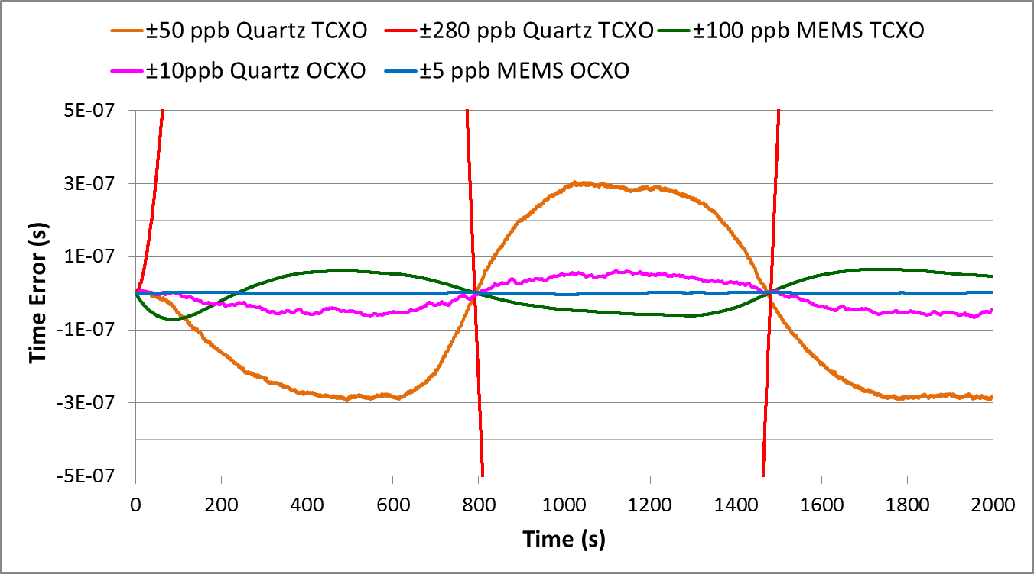
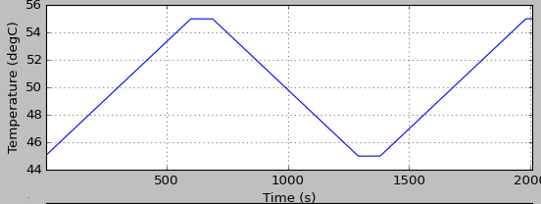
PTP Time Error (without SyncE)
Sync loop Time constant = 100s; Temperature change rate = 1°C/min
T-BC requires 100ns or 70ns Max Time Error Generation
+100 ns
-100 ns

Slide 10
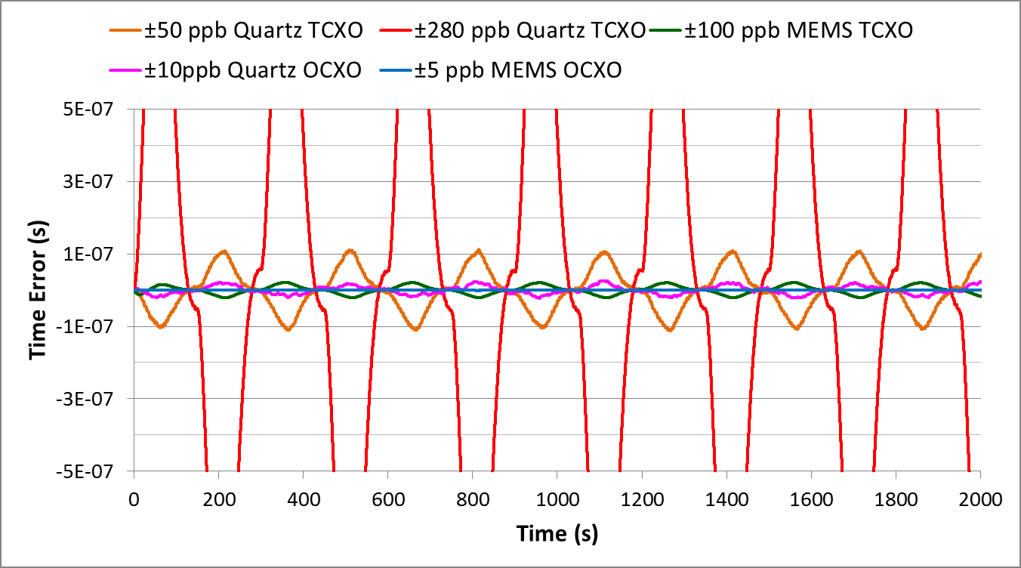
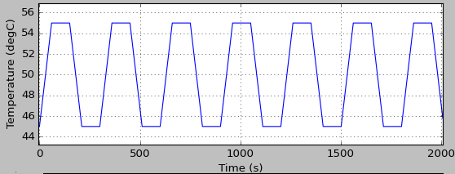
PTP Time Error (without SyncE)
Sync loop Time constant = 20s; Temperature change rate = 10°C/min
+100 ns
-100 ns
T-BC requires 100ns or 70ns Max Time Error Generation

Slide 11
PTP+SyncE Performance
SyncE assists PTP by providing frequency reference traceable to PRC
Bandwidth of SyncE loop is faster than PTP and can vary from 0.1Hz to 10Hz
Local oscillator is synchronized to PRC with 0.1Hz to 10Hz BW → equivalent of having more stable local oscillator
Temperature sensitivity of local oscillator is filtered by SyncE loop which allows keeping the performance, but using less stable oscillator
Choosing poor stability TCXO may violate MTIE/TDEV wander generation requirement, especially under environmental stressors!

Slide 12
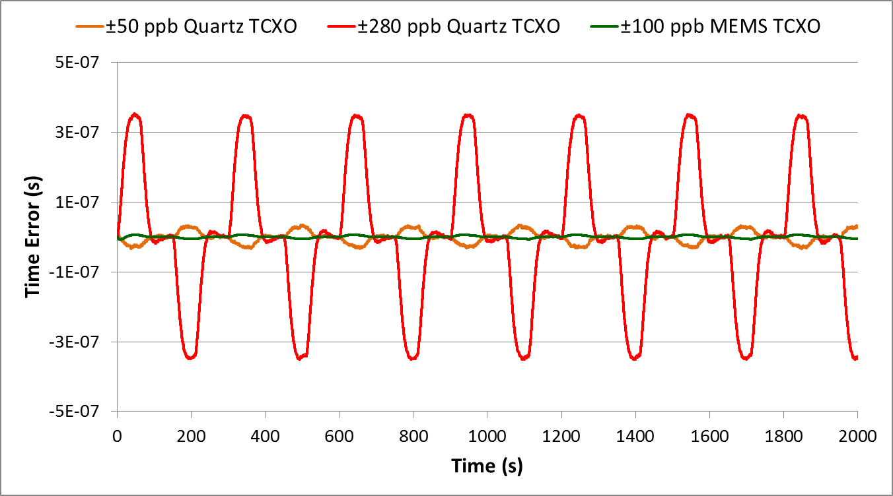
PTP+SyncE Reduces TE Generation
SyncE BW = 0.1Hz; Temperature change rate = 10°C/min
T-BC requires 100ns or 70ns Max Time Error Generation
+100 ns
-100 ns

Slide 13
Holdover Challenges
When both SyncE and PTP is lost device enters holdover mode
Holdover performance is defined by the local oscillator
Good OCXO is required to extend holdover time
Holdover measurement can be time consuming and difficult
Simulation can be used to speed up Holdover evaluation

Slide 14
Holdover Simulation
Input data used for Holdover simulation
  Frequency vs Temperature characteristic of the oscillator
  Drift rate of the oscillator
  24 hours of continuous oscillator frequency data at constant temperature
  Temperature change profile in the application
It is important to sweep starting point of Holdover calculation in time with fine step

Slide 15
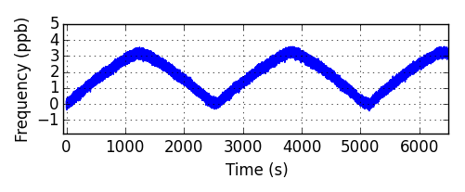
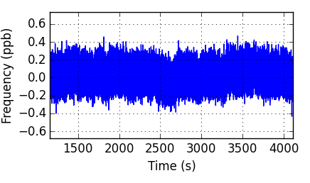
Holdover Simulation Model
~0.3 ppb/°C
~0.01 ppb/°C

Slide 16
Holdover Simulation Temperature Profile
Temperature is constantly cycled between T1 and T2 with rate of change 0.5 °C/min
After achieving high or low extreme temperature is held constant for 15 min
Low Temperature T1 = 45°C
High Temperature T2 = 55°C

Slide 17
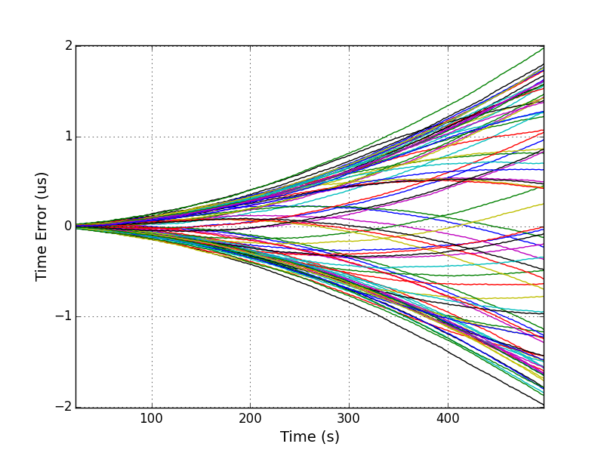
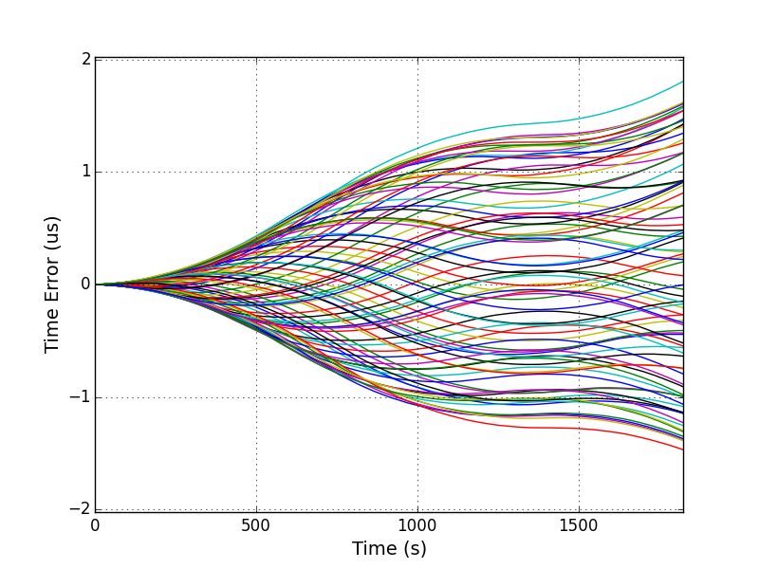
Holdover Simulation Results
Better dF/dT of MEMS TCXO leads to 3x longer Holdover time
±50 ppb Quartz TCXO
Min Holdover 5 min
±100 ppb MEMS TCXO
Min Holdover 15 min

Slide 18
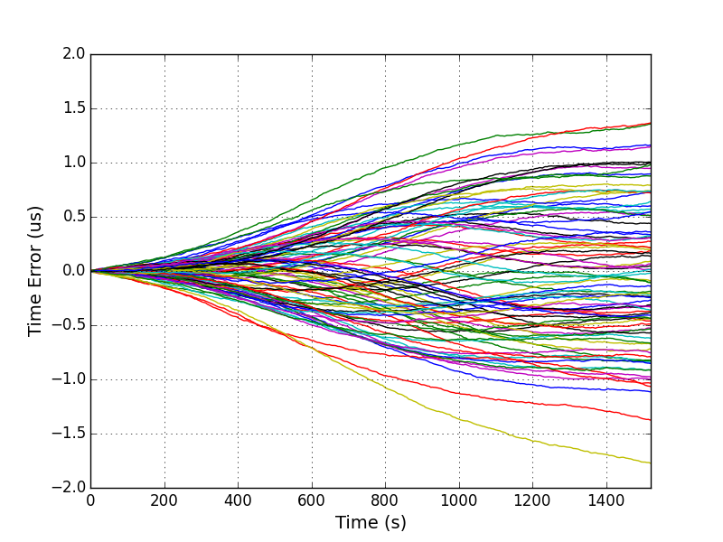
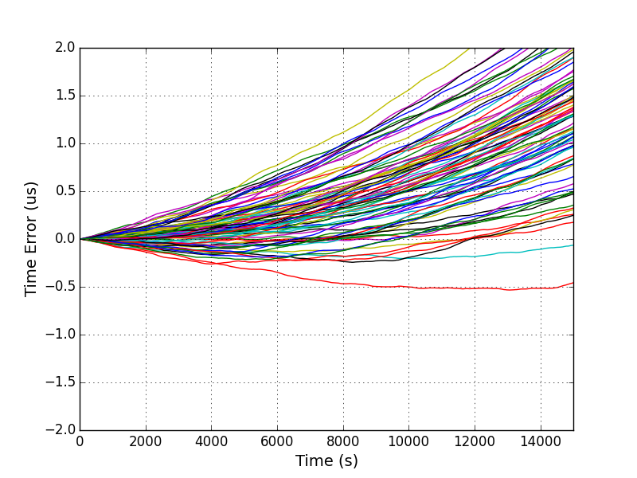
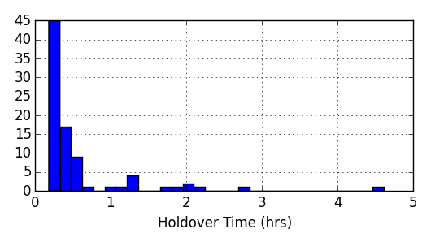
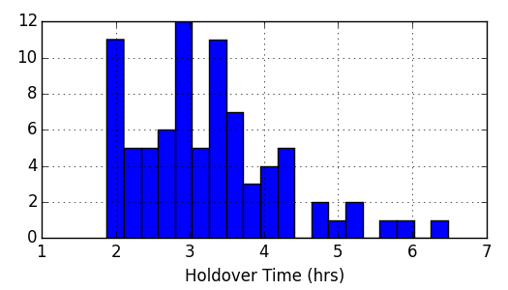
Holdover Simulation Results
Excellent dF/dT of MEMS OCXO ensures at least 2 hour Holdover time
±10 ppb Quartz OCXO
Min Holdover ~13 min
±5 ppb MEMS OCXO
Min Holdover 2 hours!

Slide 19
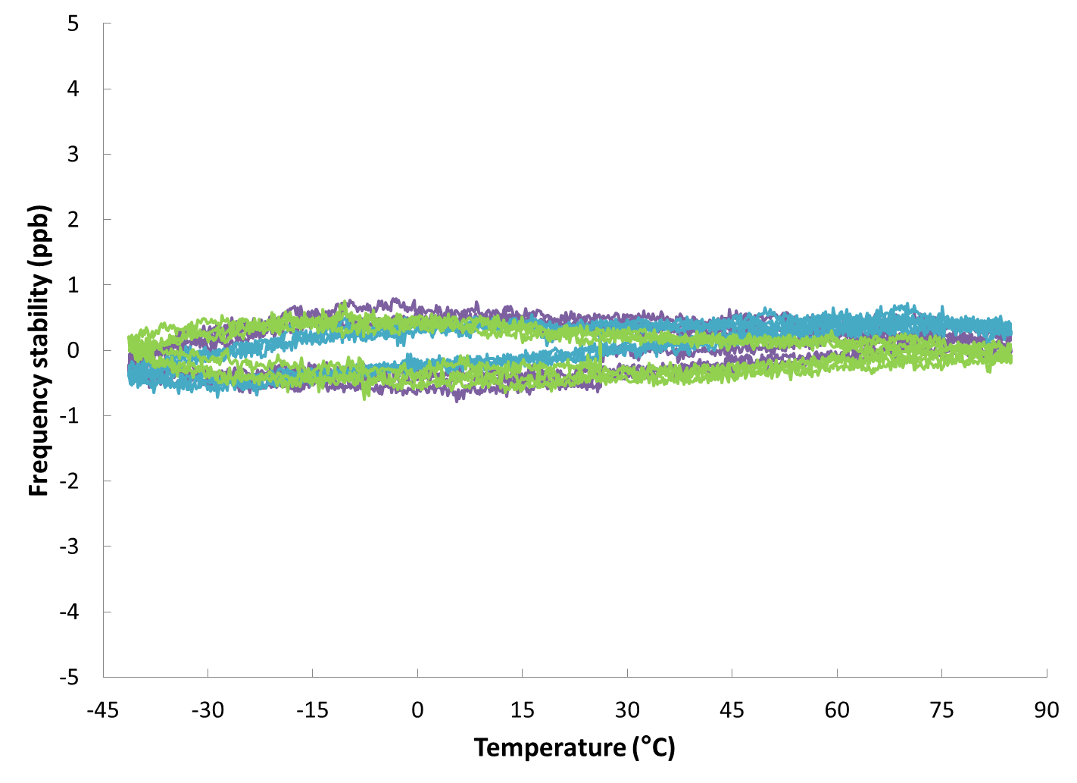
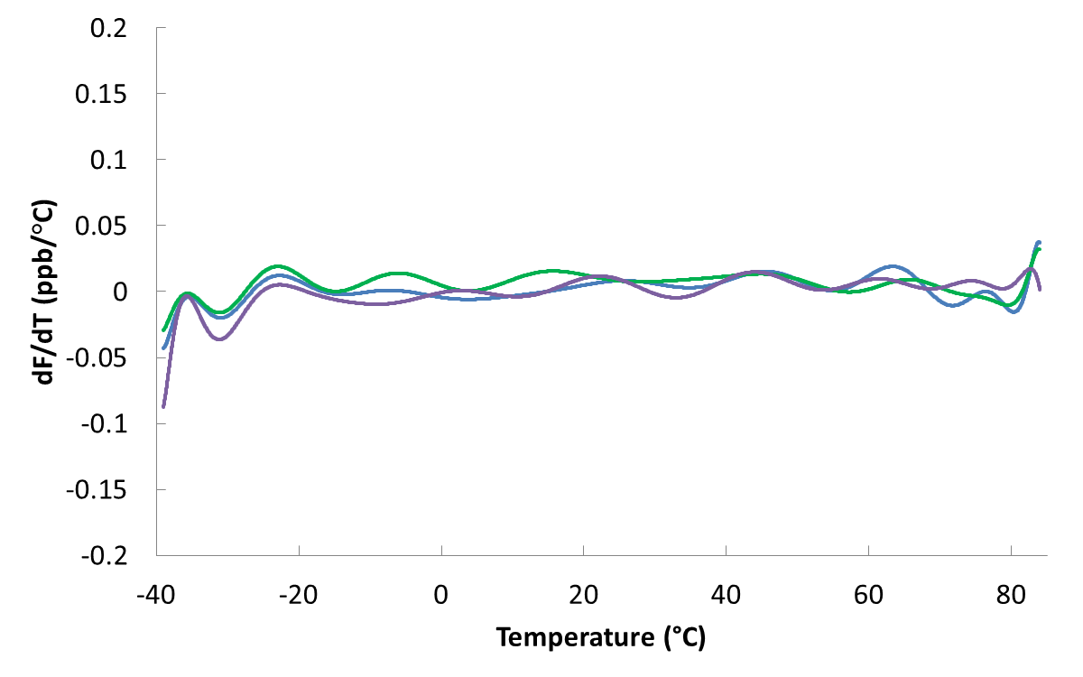
MEMS OCXO achieves 0.1 ppb/°C dF/dT
3 ppb
<0.1 ppb/°C

Slide 20
Conclusions
Good TCXO is required to meet SyncE Wander Generation specifications (MTIE and TDEV)
MEMS TCXO can achieve better Wander in real environment by minimizing dF/dT and tracking airflow changes
Stable oscillator with low dF/dT is required for good Holdover time
±100ppb MEMS TCXO can have similar to ±10ppb OCXO holdover due to comparable dF/dT
±5 ppb MEMS OCXO has excellent dF/dT and can significantly extend Holdover time of a system

